Slide 1
Presented by * Pavan kumar M jangani 3BR23CD065 * Srirama Aravind 3BR23CD092 * D K Mahatesh 3BR23CD019 * Uluru phani kumar 3BR23CD101 * Vikas hiremat 3BR23CD104
Simple Container Deployment Manager

Slide 2
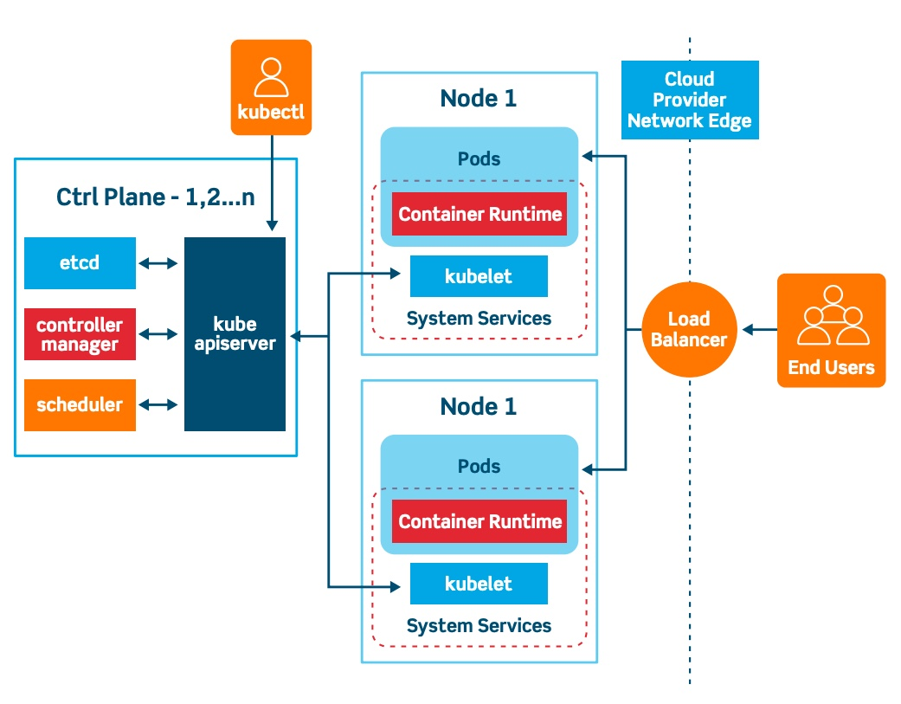
Introduction to Simple Container Deployment Manager
Simple Container Deployment Manager (SCDM) is a tool designed to simplify the deployment of containerized applications.
It streamlines the process of managing containers across various environments.
SCDM is particularly useful for developers and operations teams looking to improve efficiency in deployment workflows.
1
Notes:
Image source: https://fixlibrarystandfesttl.z4.web.core.windows.net/create-and-expose-a-deployment-in-kubernetes.html

Slide 3

Key Features of SCDM
SCDM offers a user-friendly interface that simplifies container management.
It supports multiple container orchestration platforms such as Kubernetes and Docker Swarm.
Automation capabilities enable users to deploy updates with minimal manual intervention.
2
Notes:
Image source: https://blog.advancedclinical.com/scdm-2022-key-takeaways-fundamental-shifts-in-the-data-ecosystem

Slide 4
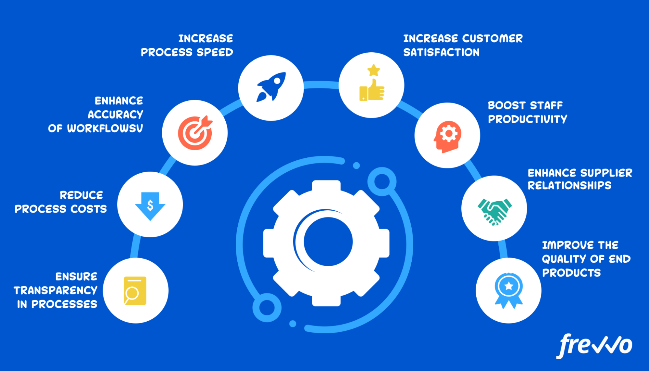
Benefits of Using SCDM
Enhanced productivity is achieved by reducing the complexity of container deployments.
SCDM minimizes deployment errors through automated processes and predefined templates.
Cost savings can be realized by optimizing resource usage and reducing downtime.
3
Notes:
Image source: https://www.frevvo.com/blog/process-improvement-tools/

Slide 5
Supported Environments
SCDM is compatible with cloud providers like AWS, Azure, and Google Cloud.
It can also be deployed on-premises, allowing for flexible deployment options.
Support for hybrid environments enables seamless management across different infrastructures.
4
Notes:
Image source: https://www.researchgate.net/figure/An-illustrative-example-of-hybrid-cloud-environment_fig1_336708771

Slide 6
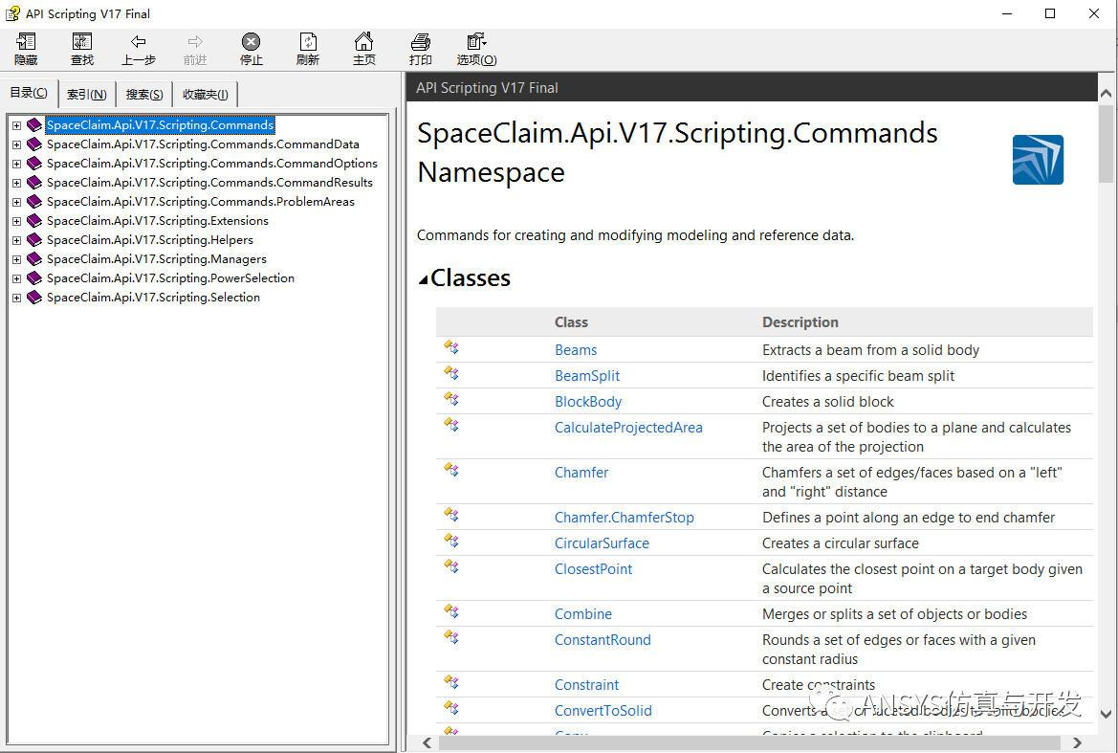
Getting Started with SCDM
Users can begin by installing the SCDM tool on their local development machines.
Configuration is straightforward, with guided steps for connecting to container registries.
Initial deployments can be executed using sample applications provided by SCDM.
5
Notes:
Image source: https://zhuanlan.zhihu.com/p/621074210

Slide 7
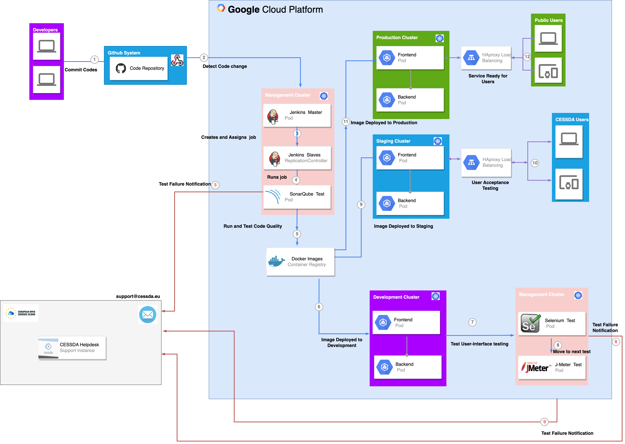
Deployment Workflow
The deployment workflow involves defining application specifications in configuration files.
Users can initiate deployments through a simple command-line interface or GUI.
Monitoring tools within SCDM provide real-time feedback during the deployment process.
6
Notes:
Image source: https://docs.tech.cessda.eu/technical-infrastructure/continuous-integration-and-deployment/deployment-workflow.html

Slide 8
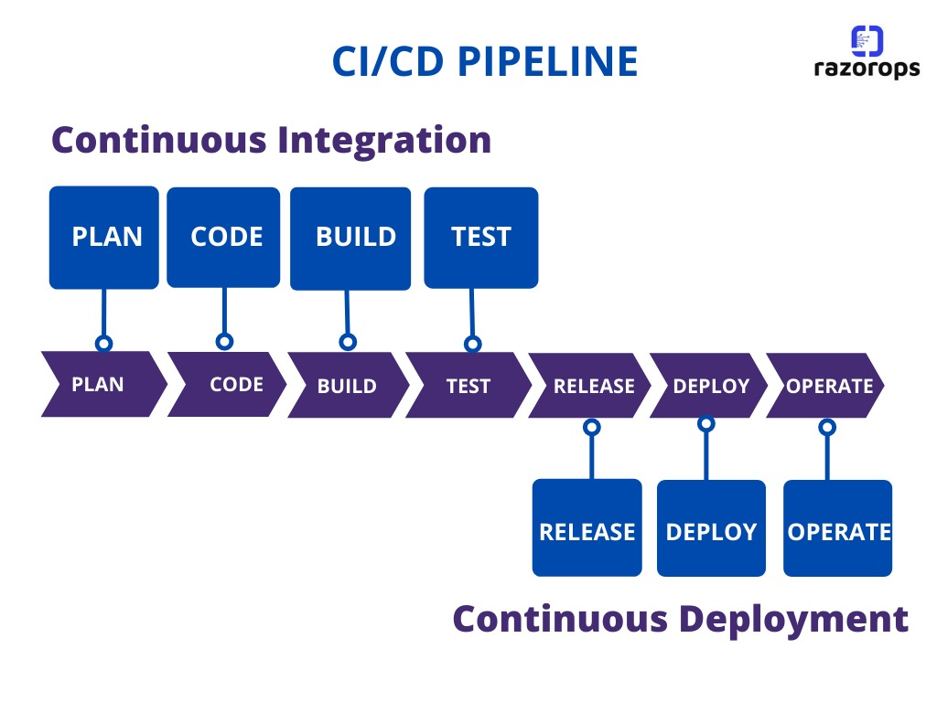
Integration with CI/CD Pipelines
SCDM can be easily integrated into existing Continuous Integration/Continuous Deployment (CI/CD) pipelines.
Automated testing and deployment ensure that containerized applications are production-ready.
This integration enhances collaboration between development and operations teams.
7
Notes:
Image source: https://razorops.com/blog/what-is-cicd-pipeline-explanation-of-cicd-pipeline-along-with-examples

Slide 9
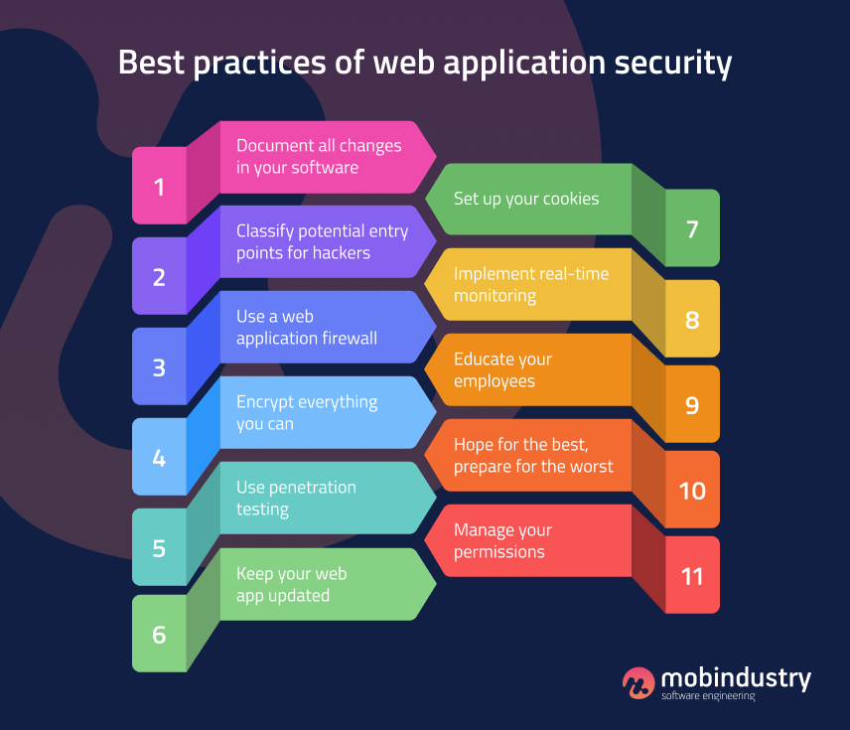
Security Features
SCDM incorporates security best practices to protect containerized applications.
Role-based access control ensures that only authorized users can deploy or modify containers.
Regular security scans help identify vulnerabilities in container images before deployment.
8
Notes:
Image source: https://www.mobindustry.net/blog/11-web-application-security-best-practices-you-need-to-know/

Slide 10

Community and Support
A vibrant community surrounds SCDM, providing resources and support for users.
Documentation, forums, and tutorials are readily available to assist with common challenges.
Professional support options are offered for enterprises that require additional assistance.
9
Notes:
Image source: https://www.alzscot.org/campaigning/eight_pillars_model_of_community_support

Slide 11
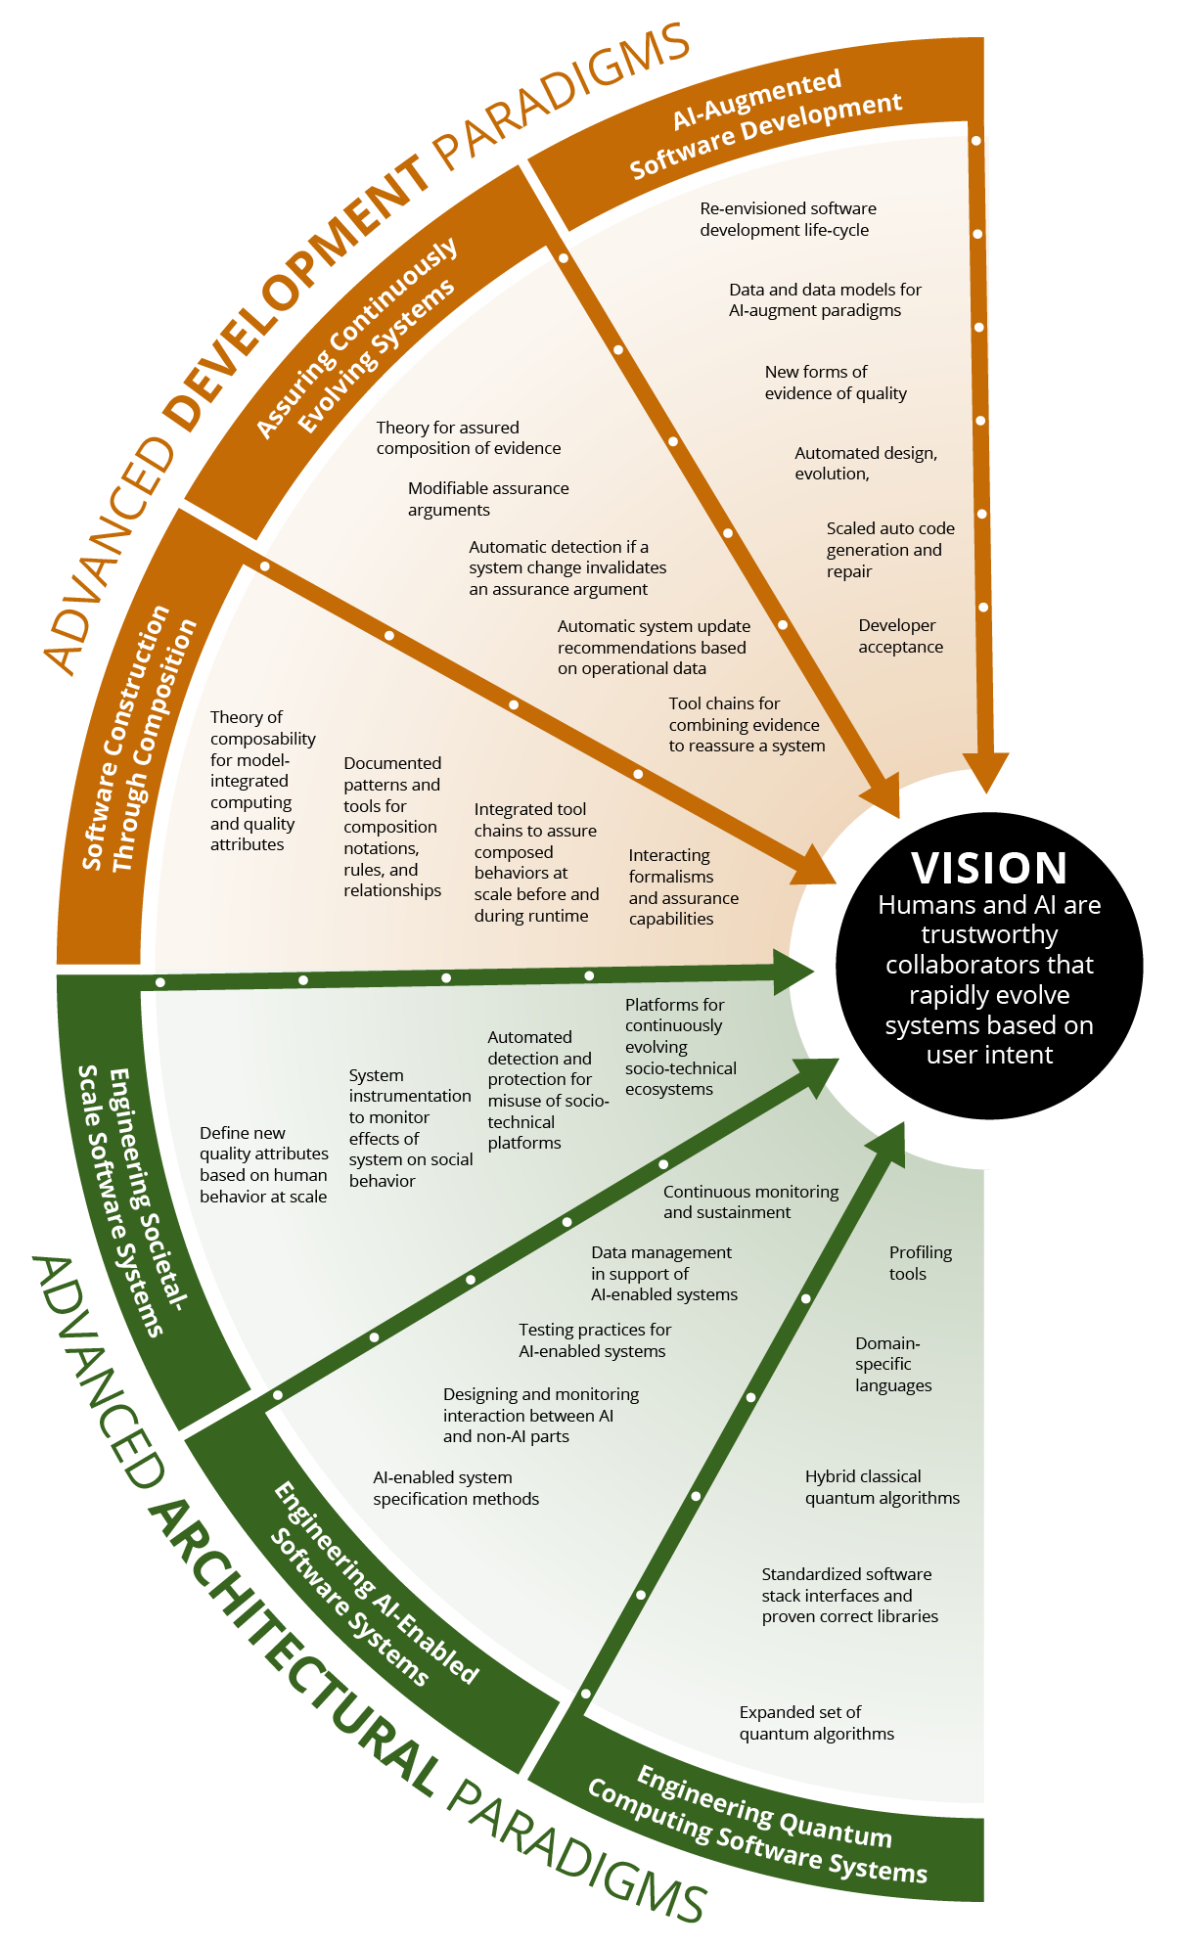
Future of SCDM
The development roadmap for SCDM includes enhanced analytics and reporting features.
Future releases will focus on improving performance and scalability for large deployments.
Continuous feedback from the user community will shape the evolution of SCDM functionalities.
10
Notes:
Image source: https://insights.sei.cmu.edu/blog/architecting-the-future-of-software-engineering-a-research-and-development-roadmap/

Slide 12
Real-Life Application and Benefits
Use Case
* This container manager could be employed in various environments, including:
* Development and Testing: Developers can deploy and manage application services quickly.
* Microservices Architecture: Each service can be managed as a separate container, enhancing modularity and ease of updates.
* Cloud Deployments: This manager can serve as a lightweight orchestration tool for deploying applications on cloud platforms.
* Imagine a food truck festival where different food trucks serve various types of cuisine. Each truck is self-contained, has its own kitchen, cooking equipment, and serves a specific menu. The organizer of the festival needs a way to manage and monitor each food truck’s setup, operation, and status during the festival.

Slide 13
Container Specs as Food Trucks:
Each food truck represents a Docker container that runs an application (in this case, it could be a web service, a database, etc.).
Each truck (container) has specific properties:
Truck Name (Container Name): The name of the food truck (container), e.g., "Taco Truck".
Type of Cuisine (Container Image): The type of service the truck provides (Docker image), e.g., "nginx
" could represent a web server, like "Taco Truck" serves tacos.
Stall Location (Port Mappings): Where the truck is located in the festival grounds, mapped to the host ports where the container is accessible.

Slide 14
Conclusion
The Simple Container Deployment Manager POC effectively demonstrates the principles of containerization and OOP in a manageable, easy-to-understand format. It serves as a foundation for more complex container orchestration tools and highlights the potential benefits of using Docker containers in modern software development practices. Further extensions could include integration with actual Docker APIs and persistent storage solutions to enhance functionality.

Slide 15
Thank you

